Slide 1
LOCKS
Method for concurrency control.

Slide 2
Database systems equipped with lock-based protocols use a mechanism by which any transaction cannot read or write data until it acquires an appropriate lock on it.
Two types of locks : Binary locks and Shared/Exclusive locks.
Both read and write operations are blocked under exclusive locks.
The use of exclusive locks helps to serialize access to the objects.
For concurrent transaction reading or single transaction writing but not both; two locks are used as read lock and write lock.

Slide 3
Lock Protocols
There are four types of lock protocols. They are :
1. Simplistic Lock Protocol
2. Pre-claiming Lock Protocol
3. Two-Phase Locking (2PL)
4. Strict Two-Phase Locking

Slide 4
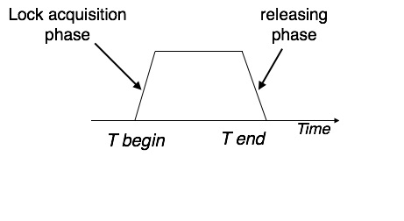
Fig : Two Phase Locking (2PL)

Slide 5
Drawbacks of Locking
Data inconsistency.
No guarantee of serializability.
Occurrence of Deadlock.

Slide 6
Deadlock
The use of locks can lead to deadlock.
The situation in which two transactions are waiting and each is dependent on the other to release a lock so as to resume is called deadlock.
Deadlock Prevention: - Lock all the objects used by a transaction when it starts.
Deadlock Detection: - A wait for graph is analyzed to detect deadlock by finding cycles. - If deadlock is present, a transaction is selected for abortion.

